Slide 1

Unit-6
Searching & Sorting Algorithms

Slide 2
Insertion Sort
Idea: like sorting a hand of playing cards
Start with an empty left hand and the cards facing down on the table.
Remove one card at a time from the table, and insert it into the correct position in the left hand
compare it with each of the cards already in the hand, from right to left
The cards held in the left hand are sorted
these cards were originally the top cards of the pile on the table

Slide 3
INSERTION SORT Algorithm
INSERTION (A,N)
This algorithm sorts the array A with N elements-
1. Set A[0]: = -∞ [Initialize Sentinel element]
2. Repeat step 3 to 5 for k=2,3,4……………N.
3. Set Temp: =A[k] and PTR=k-1;
4. Repeat while TEMP < A[PTR]:
Set A[PTR+1]:=A[PTR]. [Move element forward]
Set PTR:= PTR-1
[End of loop]
5. Set A[PTR+1]:= TEMP [Inserts element in proper place]
[End of Step 2 loop]
Return

Slide 4
Insertion Sort
input array
5 2 4 6 1 3
at each iteration, the array is divided in two sub-arrays:
left sub-array
right sub-array
sorted
unsorted

Slide 5
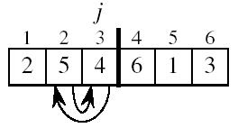
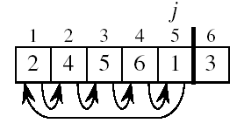
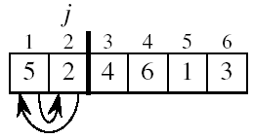
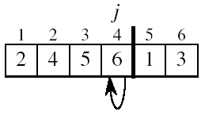
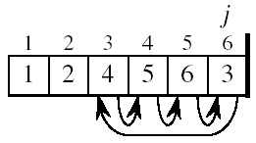
Insertion Sort

Slide 6
Selection Sort
Idea:
Find the smallest element in the array
Exchange it with the element in the first position
Find the second smallest element and exchange it with the element in the second position
Continue until the array is sorted
Disadvantage:
Running time depends only slightly on the amount of order in the file

Slide 7
Selection Sort Algorithm
Procedure- MIN(A,K,N,LOC)
An array A is in memory. This procedure finds the location LOC of the smallest element among A[K],A[K+1],…….A[N].
Set MIN:=A[K] and LOC:=K[initialize pointer]
Repeat for J=K+1,K+2…N
if Min>A[j], then : Set MIN:=A[j] and LOC:=A[j] LOC:=J
[End of Loop]
3. Return.

Slide 8
Algorithm: SELECTION(A,N)
This algorithm sorts the array A with N elements:
Repeat Steps 2 and 3 for K=1,2,…N-1:
Call MIN(A,K,N,LOC)
[Interchange A[K] and A[LOC].]
Set TEMP:=A[K],
A[K]:=A[LOC],
A[LOC]:=TEMP.
[End of Step 1 Loop]
4. Exit.

Slide 9
Example
8
4
6
9
2
3
1
1
2
3
4
9
6
8
1
4
6
9
2
3
8
1
2
3
4
6
9
8
1
2
6
9
4
3
8
1
2
3
4
6
8
9
1
2
3
9
4
6
8
1
2
3
4
6
8
9

Slide 10
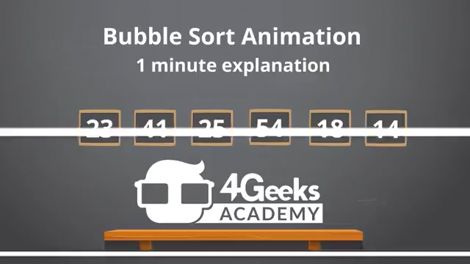
Sorting : Bubble Sort
Let A be the list of n numbers. Sorting A refers to the operation of rearranging the elements of A. i.e…
A[1] < A[2] < A[3] < ….. < A[N]
BubbleSort Animation.mp4

Slide 11
Bubble Sort
BUBBLE SORT (DATA, N)
Here DATA is an array with N elements. This algorithm sorts the elements in DATA.
1. Repeat Steps 2 and 3 for K=1 to N-1.
2. Set PTR: =1. [Initializes pass pointer PTR]
3. Repeat while PTR<=N-K: [Executes pass.]
(a)If DATA [PTR]>DATA [PTR+1], then:
Interchanges DATA [PTR] and DATA [PTR+1]
[End of If structure.]
(b)Set PTR:=PTR+1
[End of inner loop.]
[End Step1 of outer loop.]
4. Exit.

Slide 12
Quick Sort
Quick Sort is a Divide and Conquer algorithm. It picks an element as pivot and partitions the given array around the picked pivot. There are many different versions of quick Sort that pick pivot in different ways.
Always pick first element as pivot.
Always pick last element as pivot (implemented below)
Pick a random element as pivot.
Pick median as pivot.

Slide 13
Quick Sort
Algorithm:
QUICKSORT (array A, start, end)
{
1 if (start < end)
2 {
3 p = partition(A, start, end)
4 QUICKSORT (A, start, p - 1)
5 QUICKSORT (A, p + 1, end)
6 }
}
PTO continue…

Slide 14
Partition Algorithm: The partition algorithm rearranges the sub-arrays in a place.
PARTITION (array A, start, end)
{
1 pivot ? A[end]
2 i ? start-1
3 for j ? start to end -1 {
4 do if (A[j] < pivot) {
5 then i ? i + 1
6 swap A[i] with A[j]
7 }}
8 swap A[i+1] with A[end]
9 return i+1
}

Slide 15
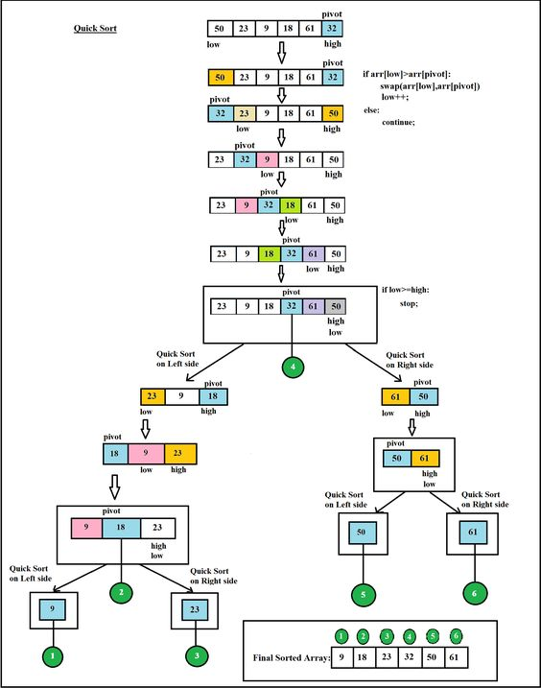

Slide 16
Merge Sort
Merge sort is a sorting technique based on divide and conquer technique. With worst- case time complexity being Ο(n log n), it is one of the most respected algorithms.
Merge sort first divides the array into equal halves and then combines them in a sorted manner.

Slide 17
Divide and Conquer
Divide: Divide the unsorted list into two sub lists of about half the size.
Conquer: Sort each of the two sub lists recursively until we have list sizes of length 1,in which case the list itself is returned.
Combine: Merge the two-sorted sub lists back into one sorted list.

Slide 18
Merge Sort Algorithm
step 1: start
step 2: declare array and left, right, mid variable
step 3: perform merge function. if left > right return mid= (left+right)/2 mergesort(array, left, mid) mergesort(array, mid+1, right) merge(array, left, mid, right)
step 4: Stop

Slide 19
Merge Sort
99 | 6 | 86 | 15 | 58 | 35 | 86 | 4 | 0
99 | 6 | 86 | 15
58 | 35 | 86 | 4 | 0
99 6
86 15
58 35
86 | 4 | 0
6 99
15 86
58 35
0 | 4 | 86

Slide 20
Merge Sort
0 | 4 | 6 | 15 | 35 | 58 | 86 | 86 | 99
6 | 15 | 86 | 99
0 | 4 | 35 | 58 | 86
6 99
15 86
58 35
0 | 4 | 86

Slide 21
Bucket Sort
In this article, we will discuss the bucket sort Algorithm. The data items in the bucket sort are distributed in the form of buckets. In coding or technical interviews for software engineers, sorting algorithms are widely asked. So, it is important to discuss the topic.
Bucket sort is a sorting algorithm that separate the elements into multiple groups said to be buckets. Elements in bucket sort are first uniformly divided into groups called buckets, and then they are sorted by any other sorting algorithm. After that, elements are gathered in a sorted manner.
The basic procedure of performing the bucket sort is given as follows -
First, partition the range into a fixed number of buckets.
Then, toss every element into its appropriate bucket.
After that, sort each bucket individually by applying a sorting algorithm.
And at last, concatenate all the sorted buckets.

Slide 22
Algorithm
Bucket Sort(A[])
1. Let B[0....n-1] be a new array
2. n=length[A]
3. for i=0 to n-1
4. make B[i] an empty list
5. for i=1 to n
6. do insert A[i] into list B[n a[i]]
7. for i=0 to n-1
8. do sort list B[i] with insertion-sort
9. Concatenate lists B[0], B[1],........, B[n-1] together in order
End

Slide 23
Example
4 | 2 | 1 | 2 | 0 | 3 | 2 | 1 | 4 | 0 | 2 | 3 | 0
0 00
1 1
2 2 22
3 3
4 4
0 | 0 | 0 | 1 | 1 | 2 | 2 | 2 | 2 | 3 | 3 | 4 | 4

Slide 24
Searching: Linear Search
DATA is linear array with N elements, and ITEM is given item of information. This algorithm finds the LOC of ITEM in DATA or Set LOC =0 if Unsuccessful.
1. [Insert ITEM at the end of DATA] set DATA[N+1] := ITEM
2. [Initialize counter] set LOC := 1
3. [Search for ITEM]
Repeat while DATA[LOC] != ITEM:
Set LOC := LOC+1
[End of loop]
4. [Successful?] if LOC = N+1, then: set LOC := 0
5. Exit

Slide 25

Linear Search Unsorted Array ( Step by Step Animation ).mp4

Slide 26
Binary Search
Binary Search (DATA, LB, UB, ITEM, LOC):
Here DATA is a sorted array with lower bound LB and upper bound UB and ITEM is a given item of information. The variables BEG, END and MID denote, respectively, the beginning, end and middle locations of a segment of elements of DATA. This algorithm finds the location LOC of ITEM in DATA or sets LOC=NULL.

Slide 27
1.[Initialize segment variables.]
Set BEG: = LB, END: =UB and MID=INT((BEG+END)/2).
2. Repeat Steps 3 and 4 while BEG<=END and
DATA [MID]! =ITEM.
3. If ITEM< DATA[MID], then:
Set END: =MID-1.
Else:
Set BEG: = MID+1.
[End of If statement.]
4. Set MID: = INT ((BEG+END)/2).
[End of Step 2 loop].
5. If DATA[MID] = ITEM, then:
Set LOC: = MID.
Else:
Set LOC: =NULL.
[End of If structure.]
6. Exit.

Slide 28

Working of Binary Search ( Step By Step Animation ).mp4

